Slide 1
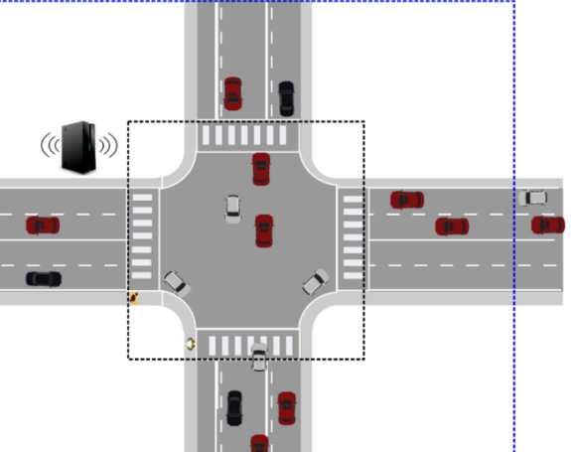
Autonomous Intersection Controller
By
Nirojan Navaratanarajah
Jaouaher Belgacem
Neaz Mahmud

Slide 2

MOTIVATION

Slide 3
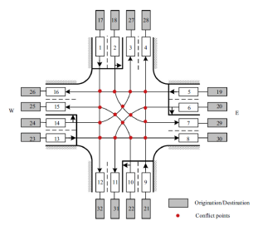
Problematic
Entry/Destination possibilities
North
East
West
South
East
West
Entry South:
Entry North:
South
North
West
South
North
East
Entry East:
Entry West:
[1]

Slide 4
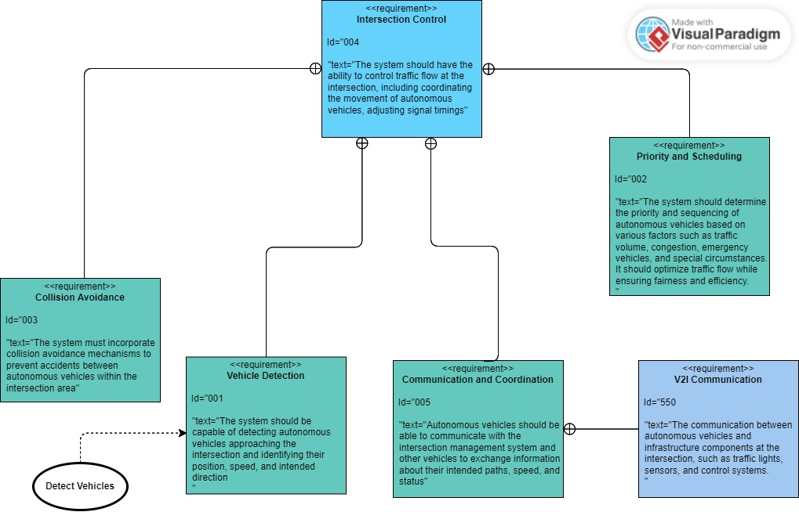
Software Modelling
Requirement Diagram

Slide 5
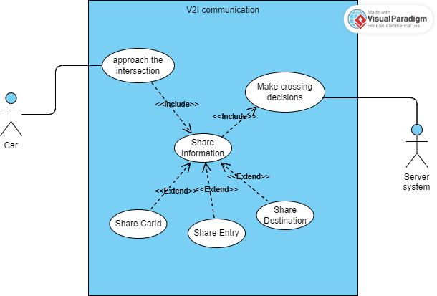
Software Modelling
Use Case Diagram

Slide 6
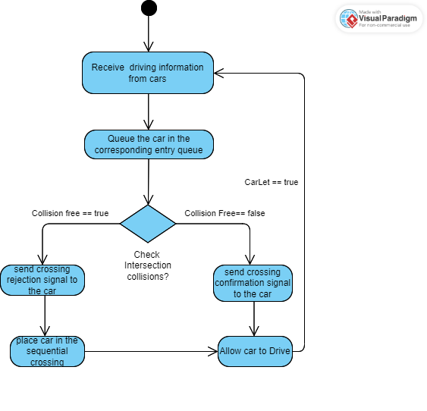
Software Modelling
Activity Diagram

Slide 7
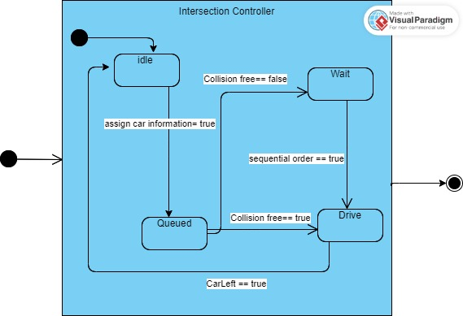
Software Modelling
State Machine Diagram

Slide 8
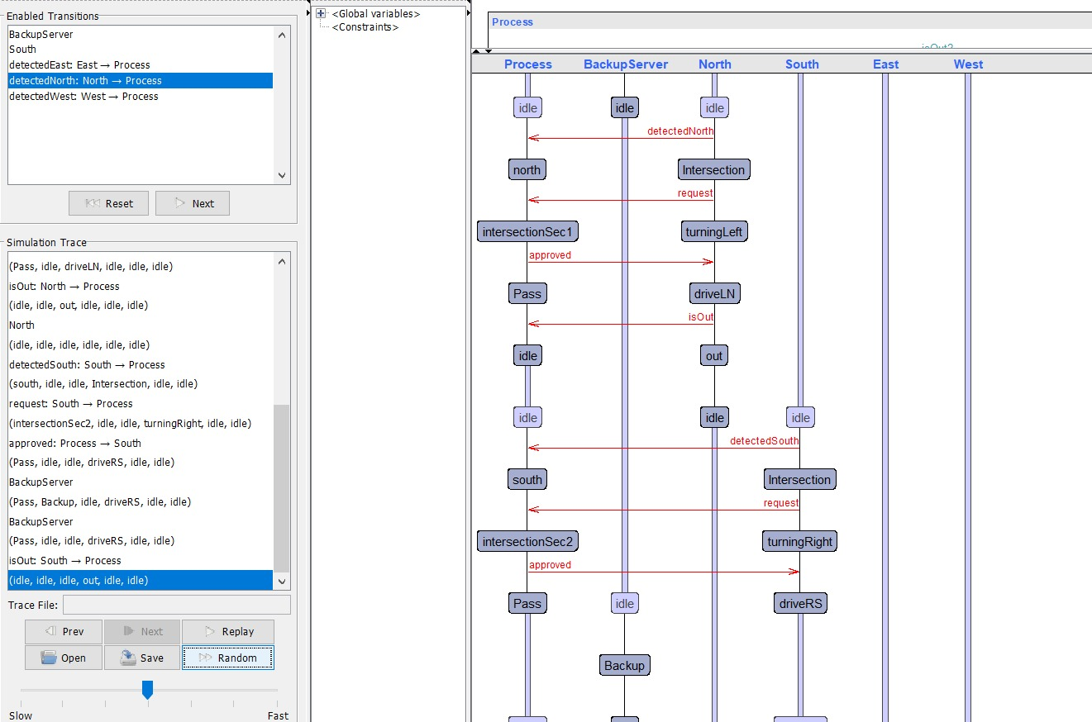
Upaal Implementation
System's simulation

Slide 9
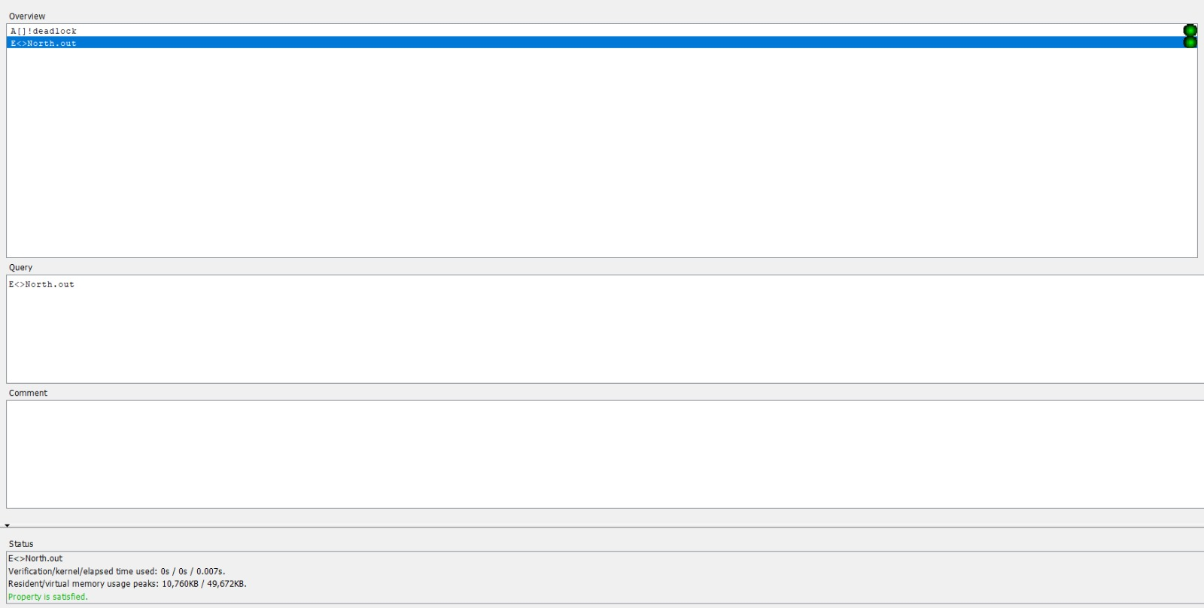
Uppaal Implementation
System's verification

Slide 10
Hw/Sw Codesign Implementation
ASIC design
Server
FreeRTOS
ASIC
Send Signal to Car
Decision from Server
Queued Vehicles
Verify
verify
Disregard \ Take necessary Action

Slide 11
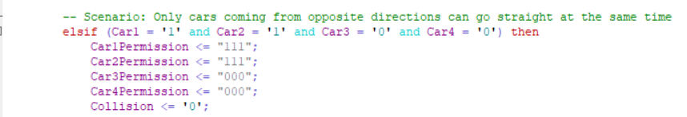
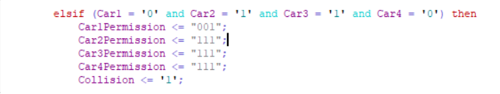
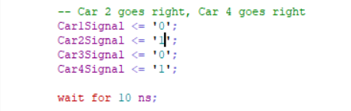
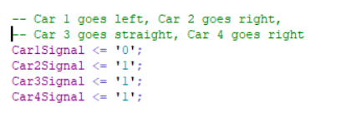
Hw/Sw Codesign Implementation
VHDL Code snippets

Slide 12
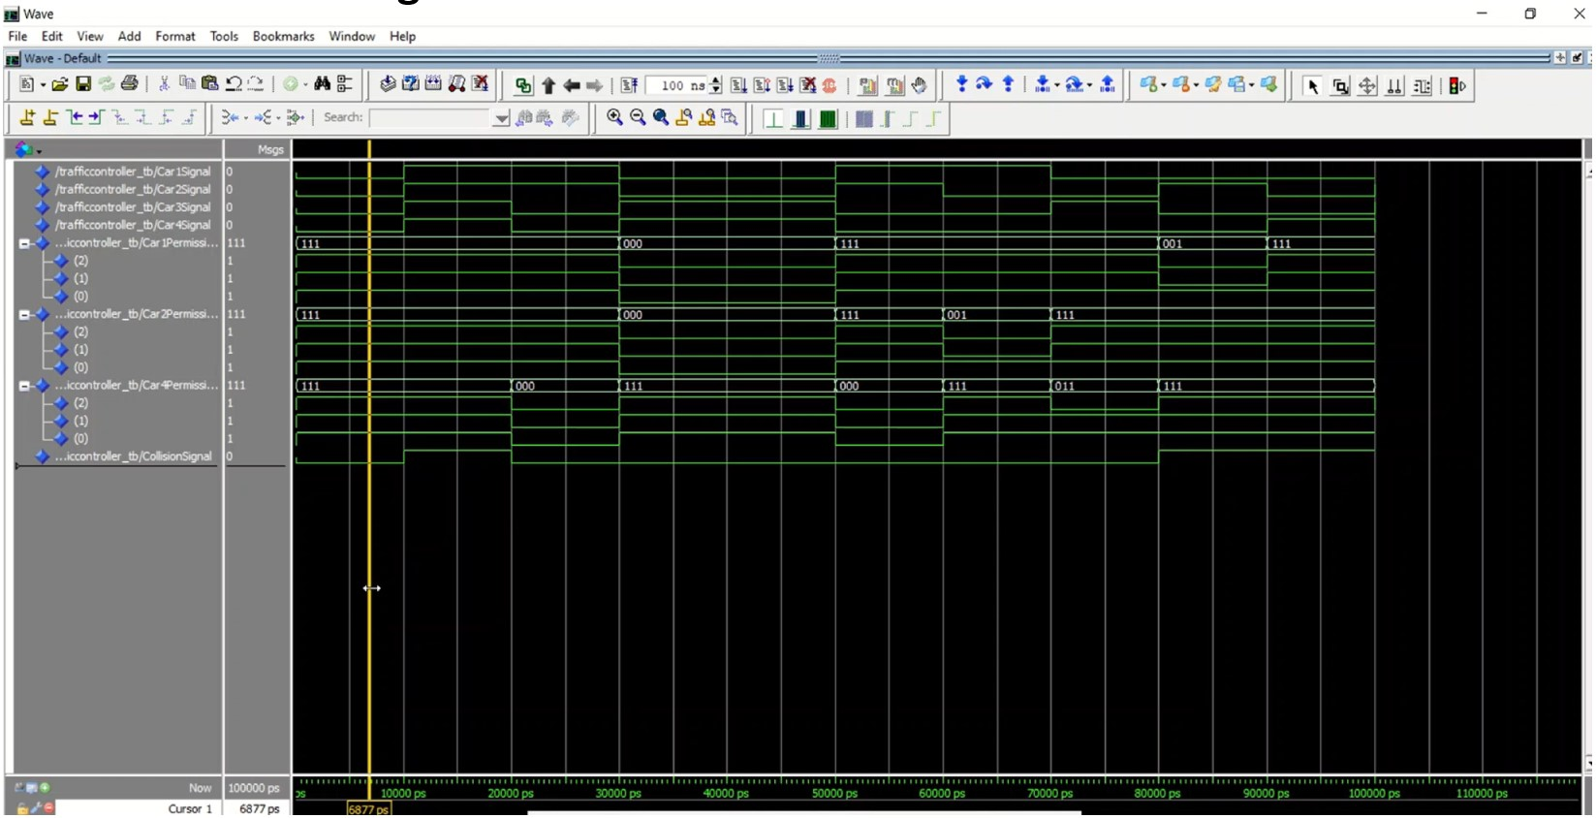
Hw/Sw Codesign Implementation
VHDL Simulation using Modelsim

Slide 13
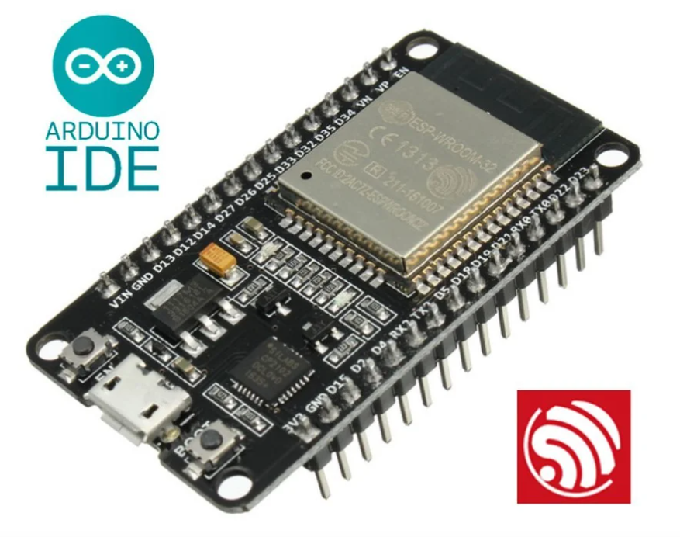

FreeRTOS Implementation
Solution approach
+
[2]
[3]

Slide 14
FreeRTOS Implemetations
Why ESP-IDF?
Advantages
Drawbacks
Enhanced Functionality (library, tools, APIs)
Access to Advanced Features (Wi-Fi, Bluetooth)
Rich Documentation and Community Support
Complexity and Development Time
Hardware-Specific (Espressif's ESP32 and ESP8266

Slide 15
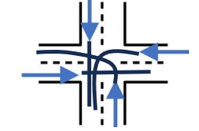
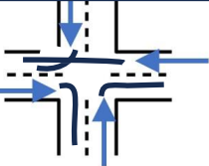
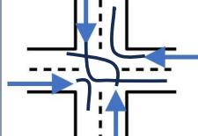
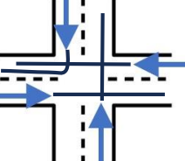
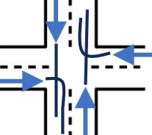
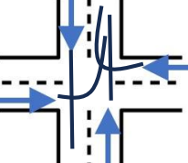
FreeRTOS Implemetations
Problematic Scenarios

Slide 16
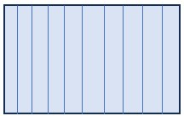
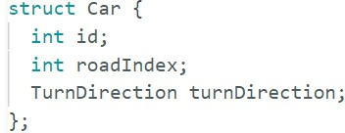
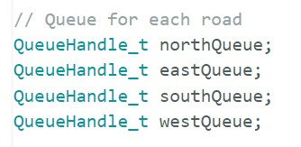
FreeRTOS Implemetations
Queuing Concept
Queue content
Intersection Controller
Core Logic Controller
Priority Decision
xQueueReceive();
xQueueSend();
ID: 456,Dir: W, RI:N
ID: 309, Dir: N, RI: E
ID:124, Dir: N, RI: N
ID:812, Dir: S, RI:W
ID: 235, Dir: N, RI: S
ID: 235, Dir: N, RI: S
ID: 921, Dir: W,RI: S
ID: 567, Dir: S, RI: E
ID: 742, Dir: E, RI: N
Int .C
ID: 235, Dir: N, RI: S
N
S
E
S

Slide 17
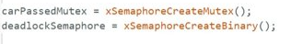
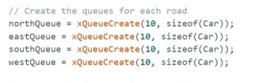
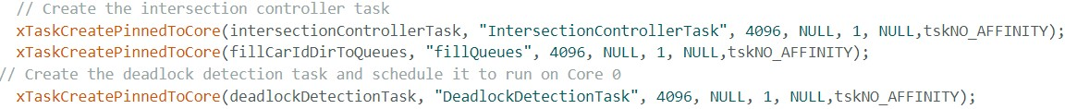
FreeRTOS Implemetations
Snippets of code
Semaphores creation
Queues creation
Tasks Creation

Slide 18
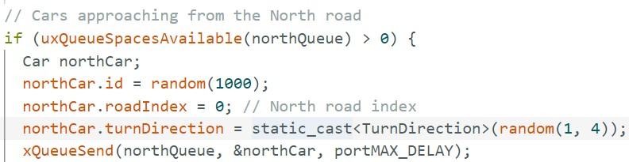
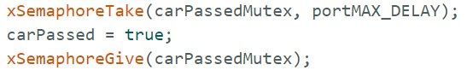
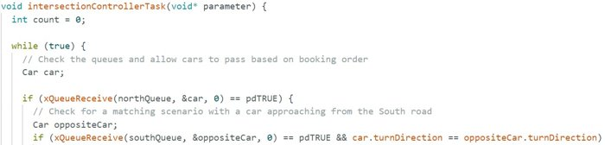
FreeRTOS Implemetations
Snippets of code
Binary Semaphore
Sending to the queue
Reading from queue

Slide 19
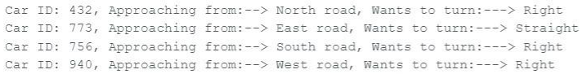
FreeRTOS Implemetations
Results

Slide 20
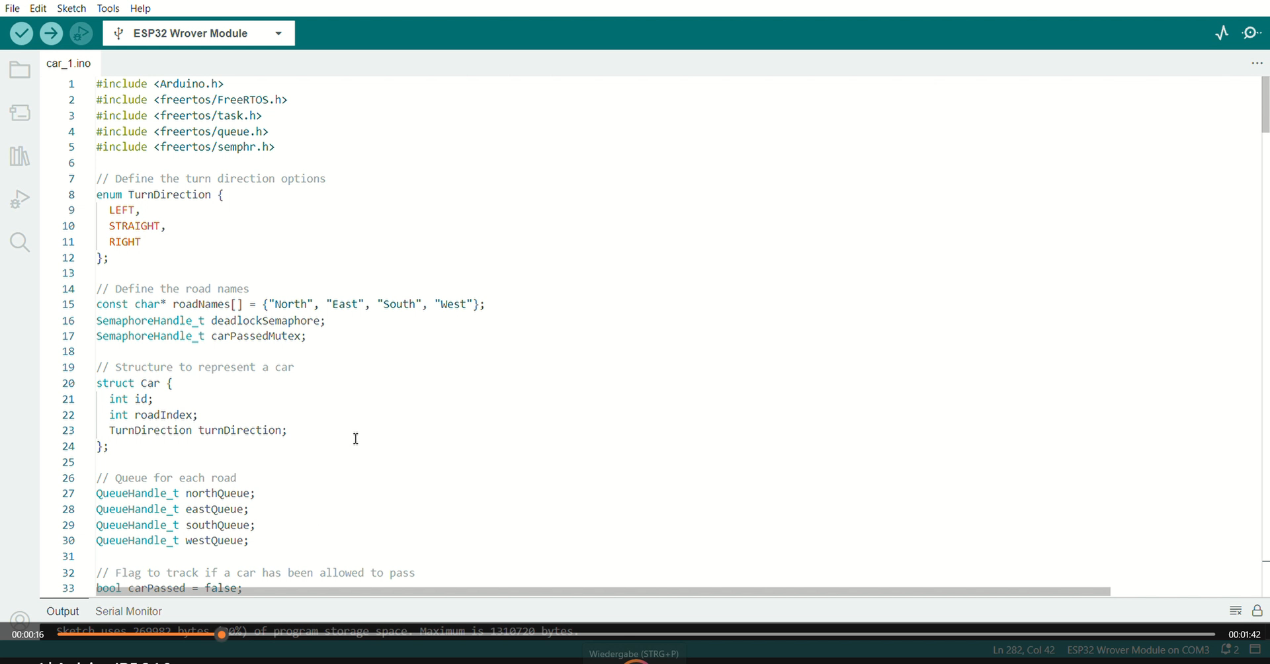
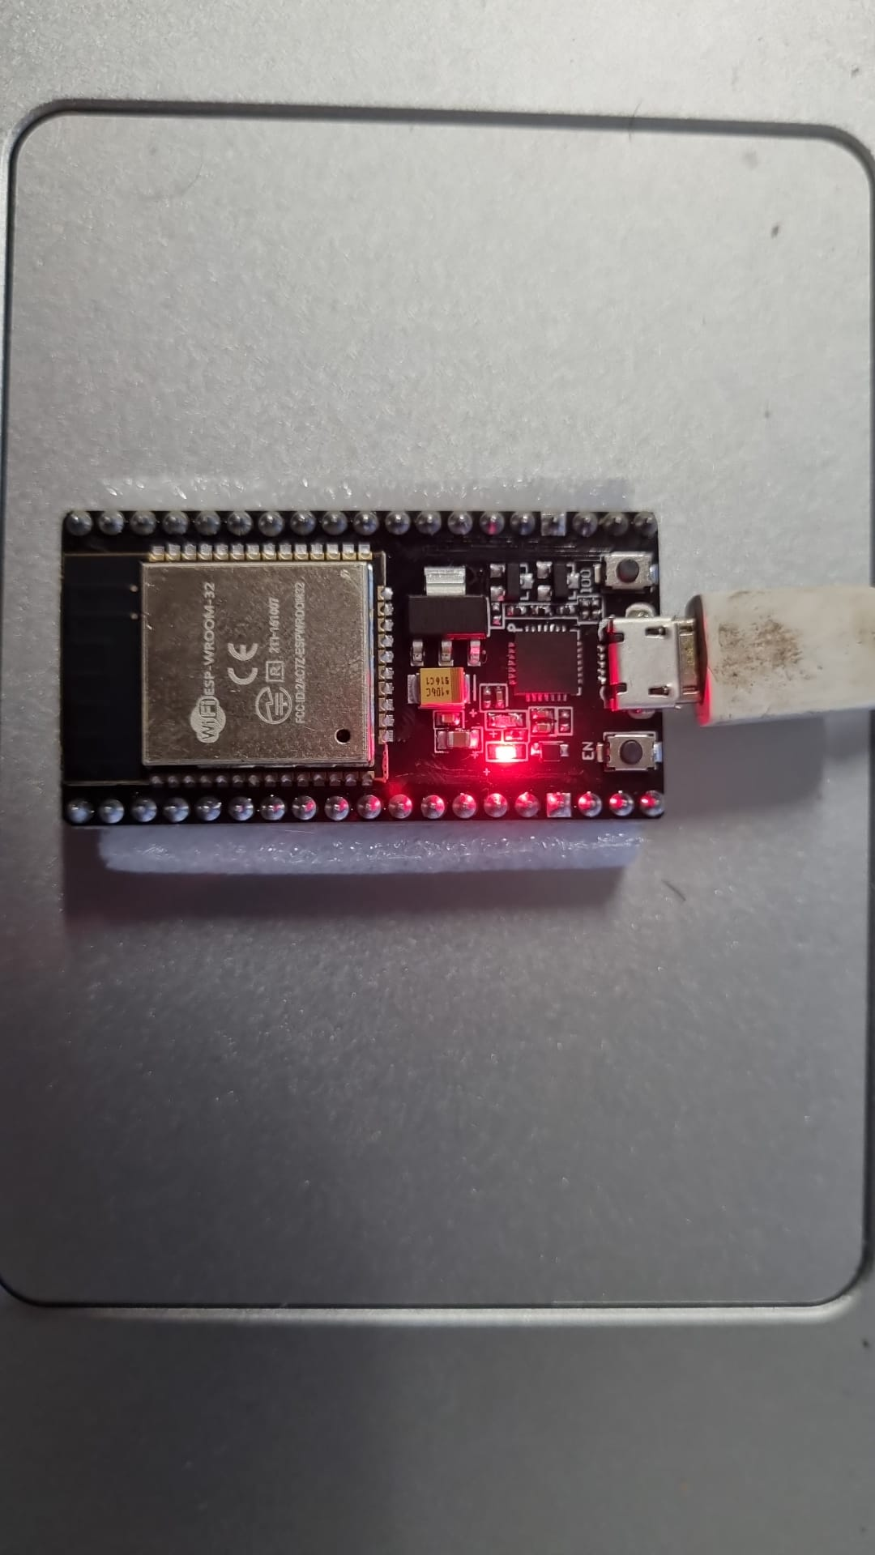
FreeRTOS Implemetations
Running FreeRTOS on Hardware

Slide 21
Conclusion

Slide 22
Questions ?

Slide 23
References
[1] S. V. U. Feng Zhu, “A linear programming formulation for autonomous intersection control within a dynamic traffic assignment and connected vehicle environment,” Transportation Research Part C, no. 55, p. 363–378, 2015
[2] https://www.freertos.org/index.html
[3] https://www.instructables.com/Installing-the-ESP32-Board-in-Arduino-IDE-Windows-/

Slide 24
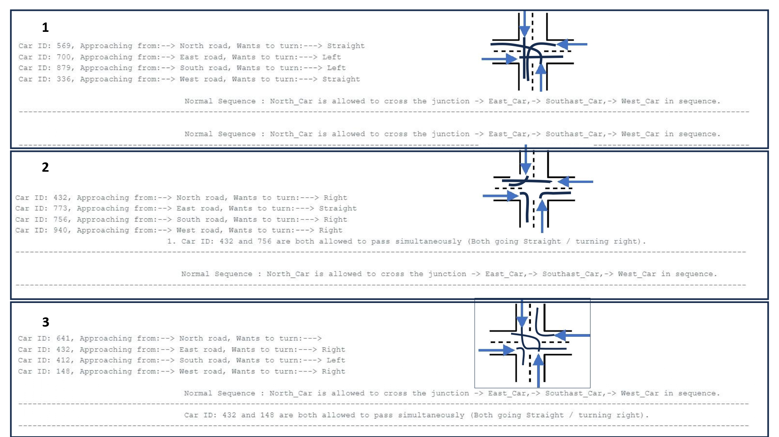
Different Scenarios on Serial Outputs 01

Slide 25
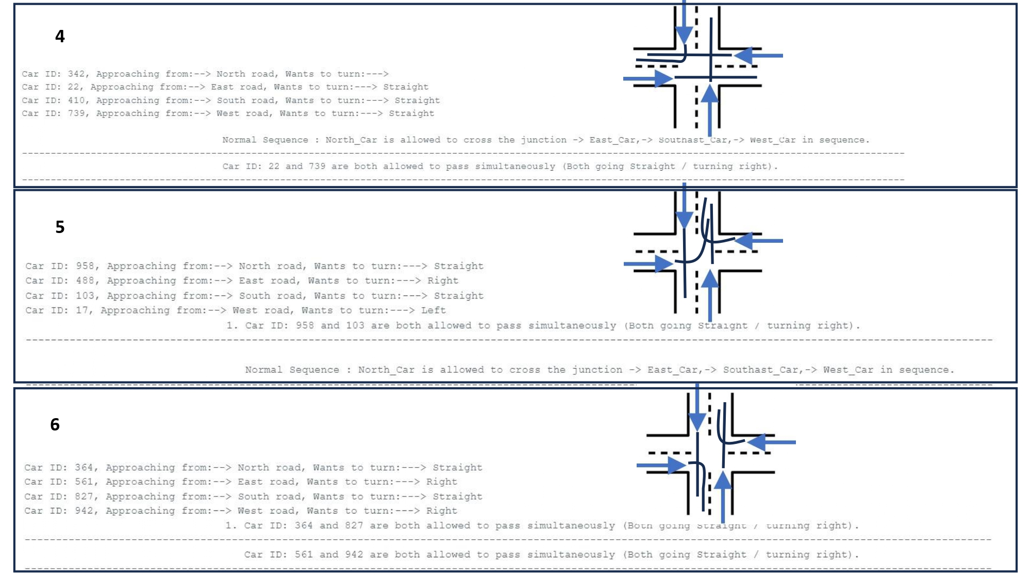
Different Scenarios on Serial Outputs 02

Slide 26
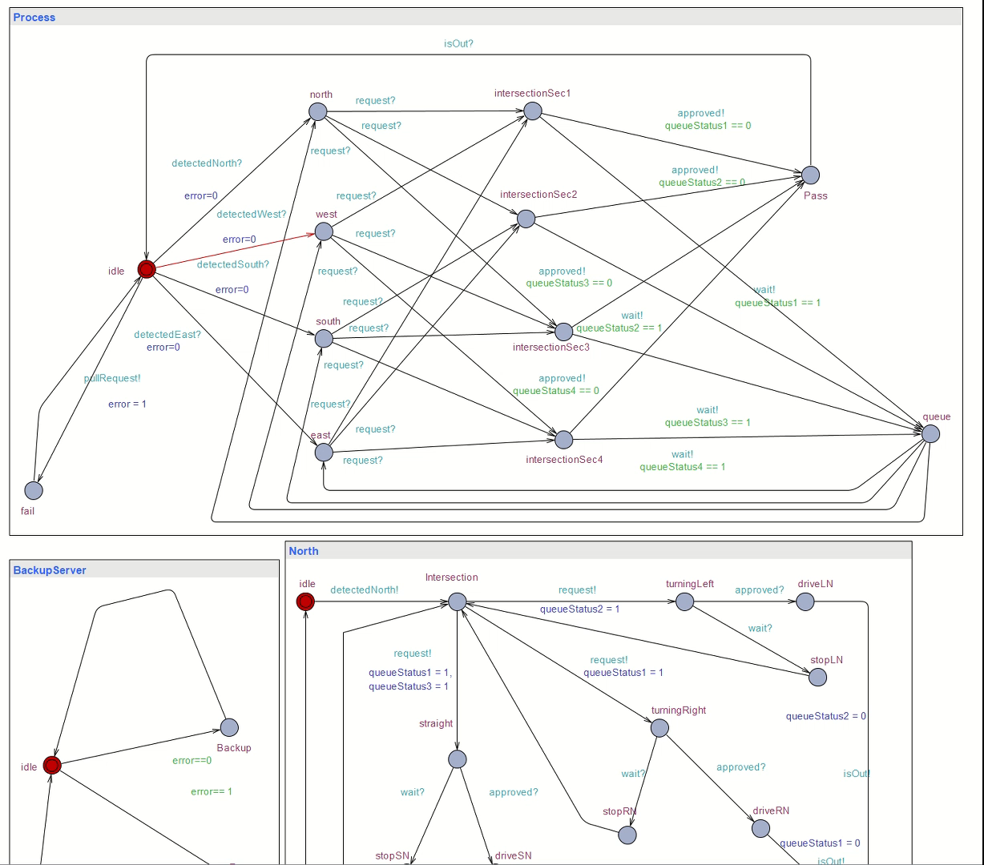
Uppaal Automata

